Slide 1

Lecture 2: Fundamentals of C Programming: Loops, Flow Control, Data Types, and Arrays,
Dr. Amir Yavariabdi
amir.yavariabdi@bth.se
1

Slide 2
Outline:
Loops in C
Flow control statements (break, continue)
Understanding Bitwise Operators in C
Arrays and Multidimensional Arrays

Slide 3
The while Repetition Statement
Repetition structure
Programmer specifies an action to be repeated while some condition remains true
Pseudocode:
While there are more items on my shopping list
Purchase next item and cross it off my list
while loop repeated until condition becomes false
Example:
int product = 2;
while ( product <= 1000 )
product = 2 * product;

Slide 4
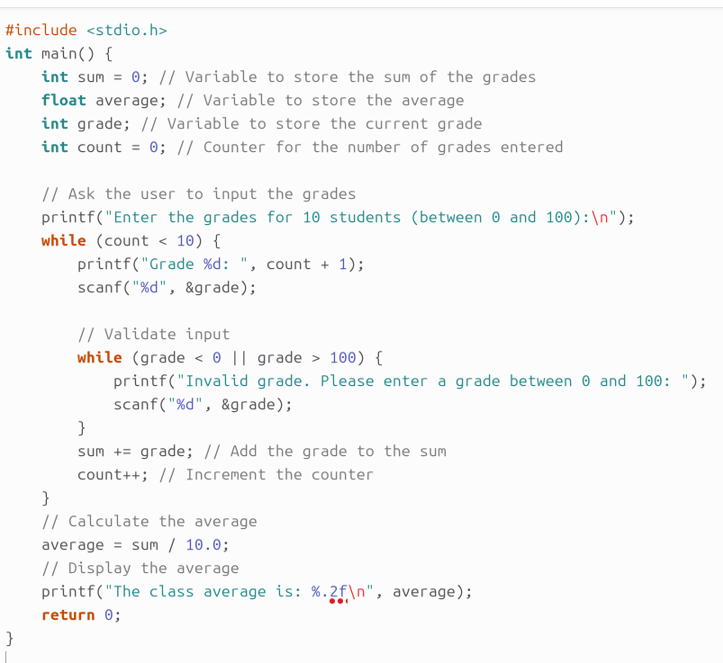
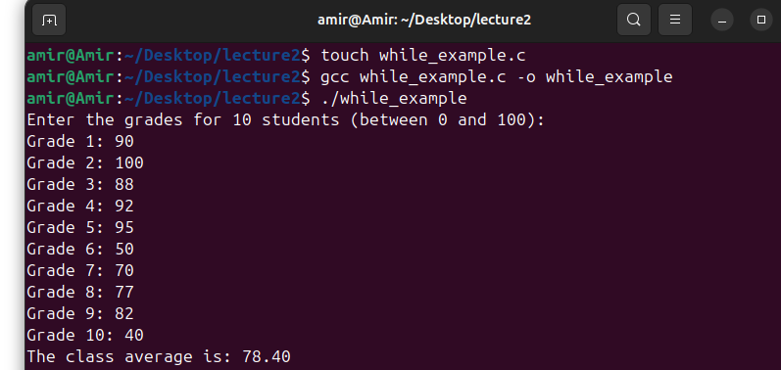
Example 1: while Loop
A class of 10 students took a quiz. The grades (integers in the range 0 to 100) for this quiz are available to you. Determine the class average on the quiz.

Slide 5
Example 1: Explanation
Declare and initialize variables sum to 0, count to 0, and a float average to store the final average.
Ask the user to enter the grades for each student within the range of 0 to 100.
Use a while loop to read the grades. The loop will continue until 10 valid grades have been entered.
Validate the grade input inside the while loop to ensure it is between 0 and 100. If an invalid grade is entered, ask the user again.
Accumulate the grades in the sum variable and increment the count.
Calculate the average by dividing the sum by 10.0 (float).
Print the average to two decimal places.

Slide 6
The while Repetition Statement
Common Programming Error:
If a counter or total is not initialized, the results of our program will probably be incorrect.
This is an example of a logic error.
Then, we must initialize all counters and totals.

Slide 7
break and continue Statements
break statement:
Used for exiting immediately and rapidly from certain control structures
continue statement:
Used for skipping the remainder of the body of a repetition structure and proceeding with the next iteration of the loop proceeds with the next iteration of the loop.

Slide 8
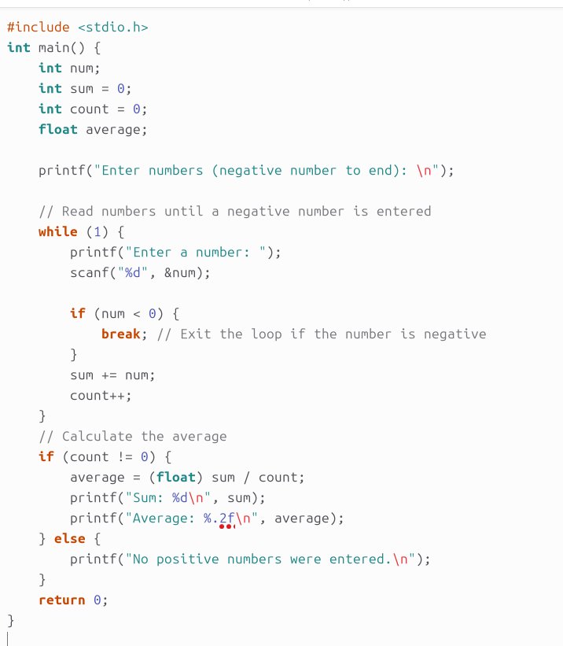
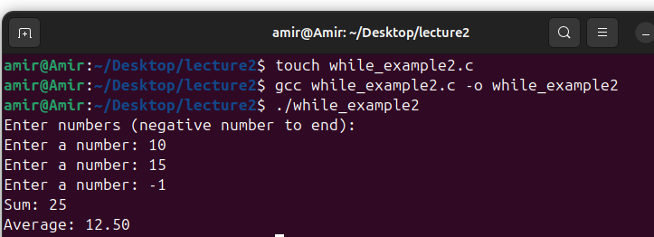
Example 2: while Loop
Write a C program that reads integers from the user until the user enters a negative number. The program should calculate and print the sum and average of the entered numbers, excluding the negative number.

Slide 9
Example 2: Explanation
Declare variables:
num for the current number, sum for the sum of the numbers, count for the number of entered positive numbers, and average for the average.
Ask the user to enter numbers.
Use a while(1) loop to continuously read integers from the user.
Check if the entered number is negative:
If it is negative, exit the loop using break.
If it is positive, add the number to sum and increment count.
Calculate the average after exiting the loop, provided at least one positive number was entered.
Print the sum and average or notify the user if no positive numbers were entered.

Slide 10
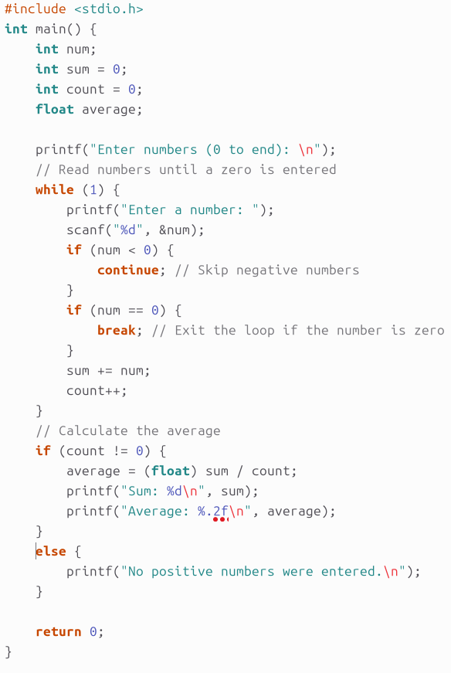
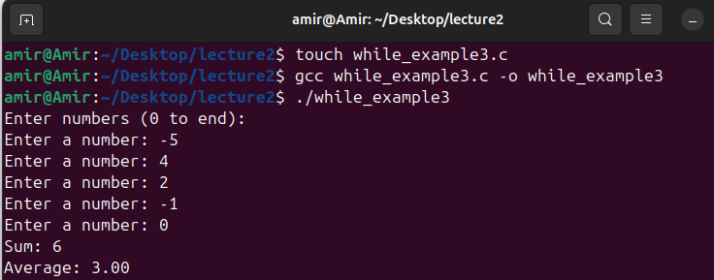
Example 3: while Loop
Write a C program that reads integers from the user until the user enters a zero. The program should skip any negative numbers using the continue statement and break out of the loop when the user enters a zero. It should calculate and print the sum and average of the entered positive numbers.

Slide 11
Example 3: Explanation
Declare variables:
num for the current number, sum for the sum of the numbers, count for the number of entered positive numbers, and average for the average.
Ask the user to enter numbers.
Use a while(1) loop to continuously read integers from the user.
Check if the entered number is negative:
If it is negative, use continue to skip the rest of the loop and prompt for the next number.
Check if the entered number is zero:
If it is zero, use break to exit the loop.
If the number is positive, add it to sum and increment count.
Calculate the average after exiting the loop, provided at least one positive number was entered.
Print the sum and average or notify the user if no positive numbers were entered.

Slide 12
The for Repetition Statement
The syntax of the for loop is:
for (initializationStatement; testExpression; updateStatement)
{
// statements inside the body of loop
}
How for loop works?
The initialization statement is executed only once.
Then, the test expression is evaluated.
If the test expression is evaluated to false, the for loop is terminated.
If the test expression is evaluated to true, statements inside the body of the for loop are executed, and the update expression is updated.
This process goes on until the test expression is false.
When the test expression is false, the loop terminates.

Slide 13
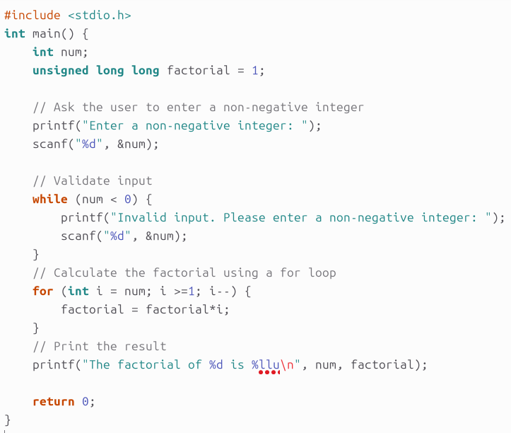
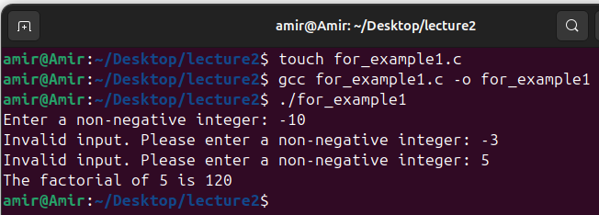
Example 4: for Loop
Write a C program that calculates the factorial of a number entered by the user using a for loop. The program should ask the user to enter a non-negative integer, calculate the factorial, and then print the result.

Slide 14
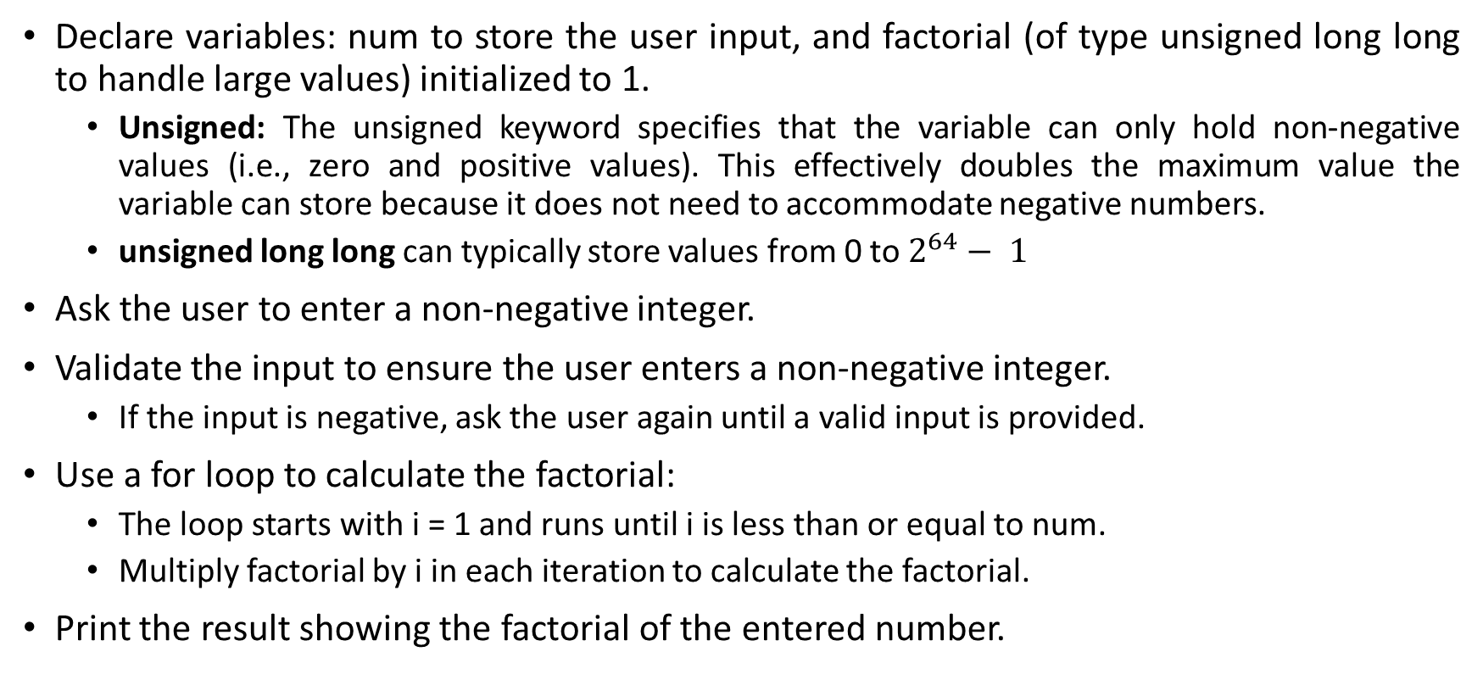
Example 4: Explanation
Declare variables: num to store the user input, and factorial (of type unsigned long long to handle large values) initialized to 1.
Unsigned: The unsigned keyword specifies that the variable can only hold non-negative values (i.e., zero and positive values). This effectively doubles the maximum value the variable can store because it does not need to accommodate negative numbers.
unsigned long long can typically store values from 0 to $2^{64}− 1$
Ask the user to enter a non-negative integer.
Validate the input to ensure the user enters a non-negative integer.
If the input is negative, ask the user again until a valid input is provided.
Use a for loop to calculate the factorial:
The loop starts with i = 1 and runs until i is less than or equal to num.
Multiply factorial by i in each iteration to calculate the factorial.
Print the result showing the factorial of the entered number.

Slide 15
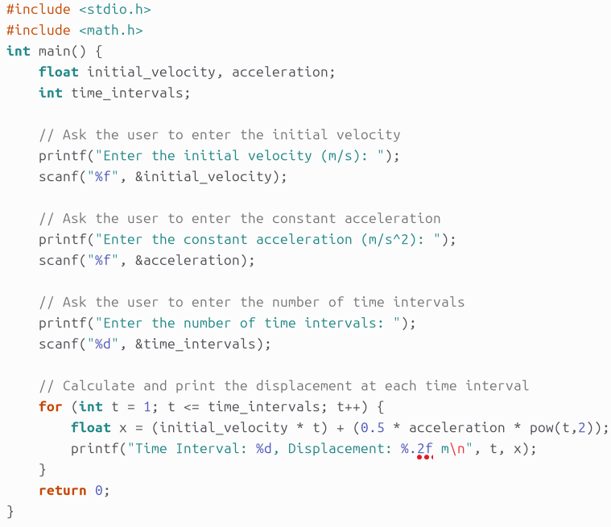
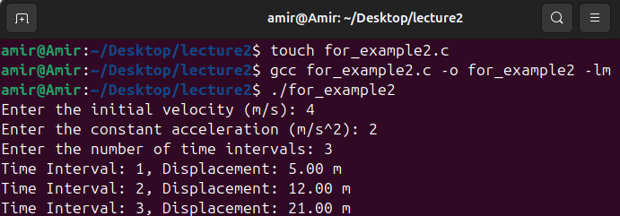
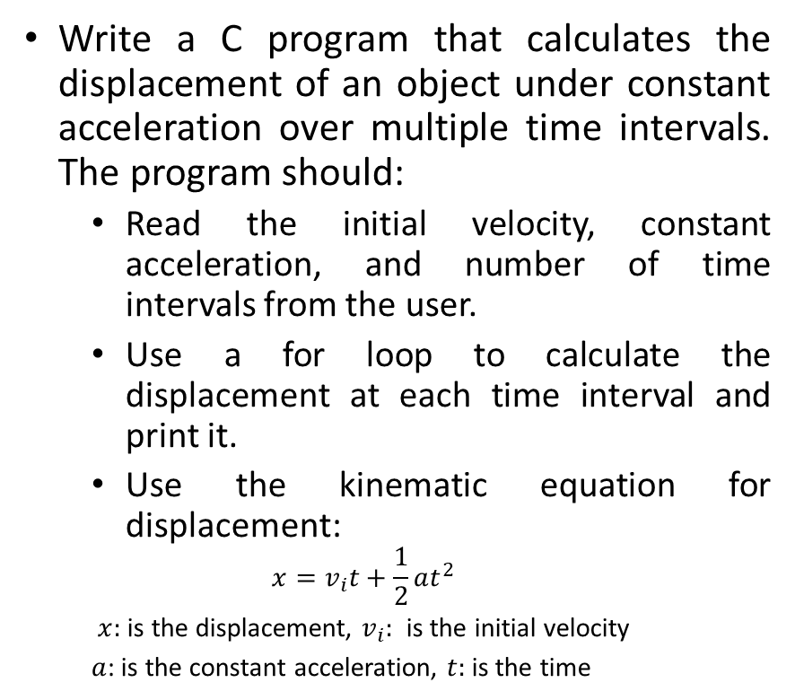
Example 5: for Loop
Write a C program that calculates the displacement of an object under constant acceleration over multiple time intervals. The program should:
Read the initial velocity, constant acceleration, and number of time intervals from the user.
Use a for loop to calculate the displacement at each time interval and print it.
Use the kinematic equation for displacement:
$$x=v_{i}t+\frac{1}{2}at^{2}$$
$x:$is the displacement, $v_{i}:$ is the initial velocity
$a$: is the constant acceleration, $t:$ is the time

Slide 16
Example 5: Explanation
Declare variables: initial_velocity, acceleration, and time_intervals to store the respective values.
Ask the user to enter the initial velocity, constant acceleration, and number of time intervals.
Use a for loop to iterate through each time interval:
Calculate the displacement using the kinematic equation.
Print the displacement for each time interval.

Slide 17
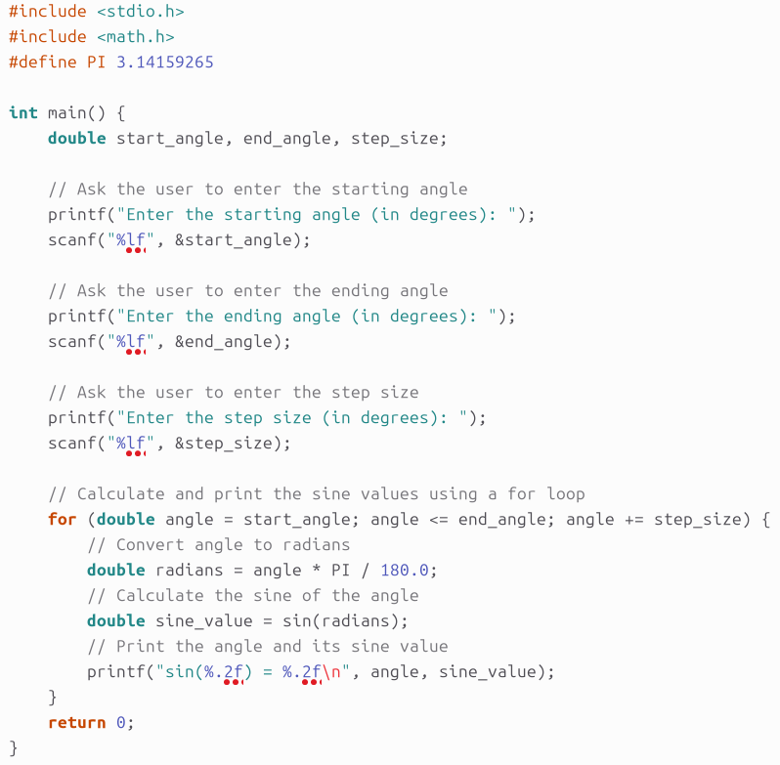
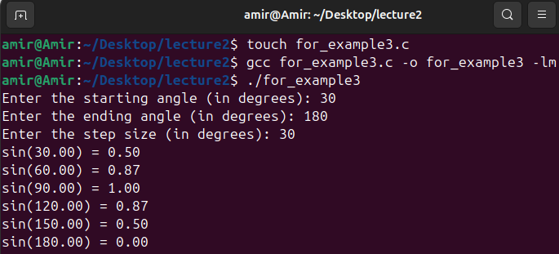
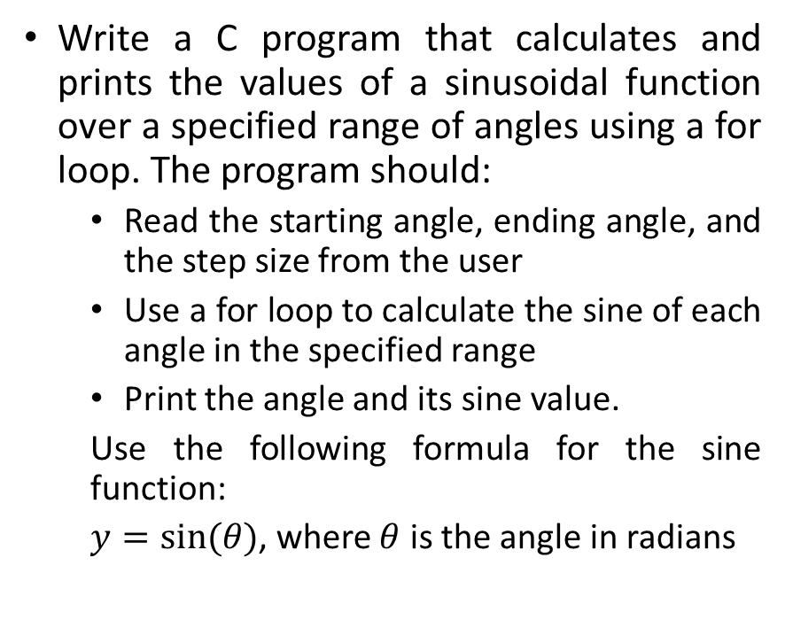
Example 6: for Loop
Write a C program that calculates and prints the values of a sinusoidal function over a specified range of angles using a for loop. The program should:
Read the starting angle, ending angle, and the step size from the user
Use a for loop to calculate the sine of each angle in the specified range
Print the angle and its sine value.
Use the following formula for the sine function:
$y=sin⁡(θ)$, where $θ$ is the angle in radians

Slide 18
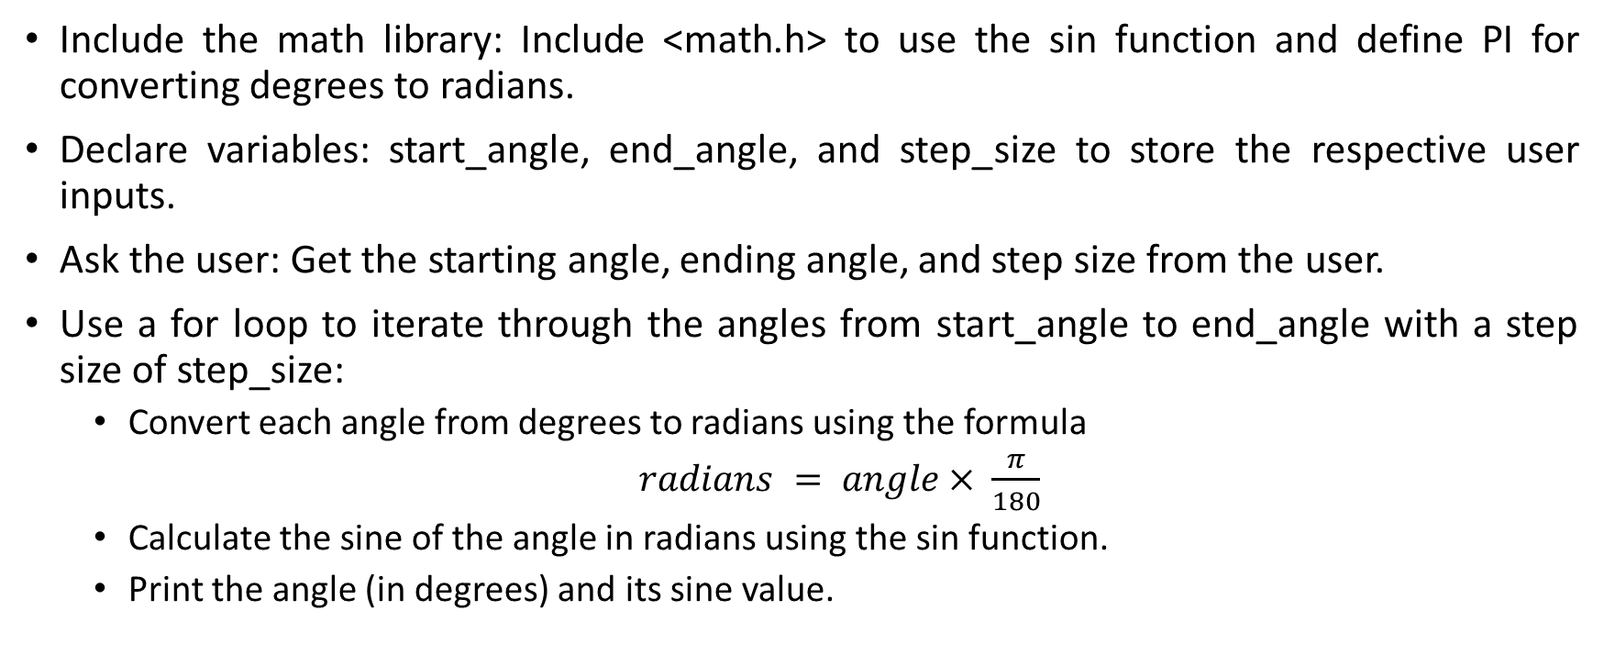
Example 6: Explanation
Include the math library: Include <math.h> to use the sin function and define PI for converting degrees to radians.
Declare variables: start_angle, end_angle, and step_size to store the respective user inputs.
Ask the user: Get the starting angle, ending angle, and step size from the user.
Use a for loop to iterate through the angles from start_angle to end_angle with a step size of step_size:
Convert each angle from degrees to radians using the formula
$radians = angle× \frac{π}{180}$
Calculate the sine of the angle in radians using the sin function.
Print the angle (in degrees) and its sine value.

Slide 19
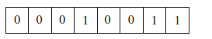
Understanding Bit Models
A bit is a binary valued variable and is the smallest unit of data in a computer.
The two possible values are typically written as 1 and 0, or true and false.
Since a single bit can only represent only two values, we must group bits together to:
represent a wider range of numbers and
manipulate data at the binary level
within computing systems.
The most common grouping is a byte, which is 8 bits grouped in sequence.
For example, the following is a byte:
When bits are grouped, there are a variety of methods for interpreting them collectively.
Each method of interpretation is called a bit model.

Slide 20
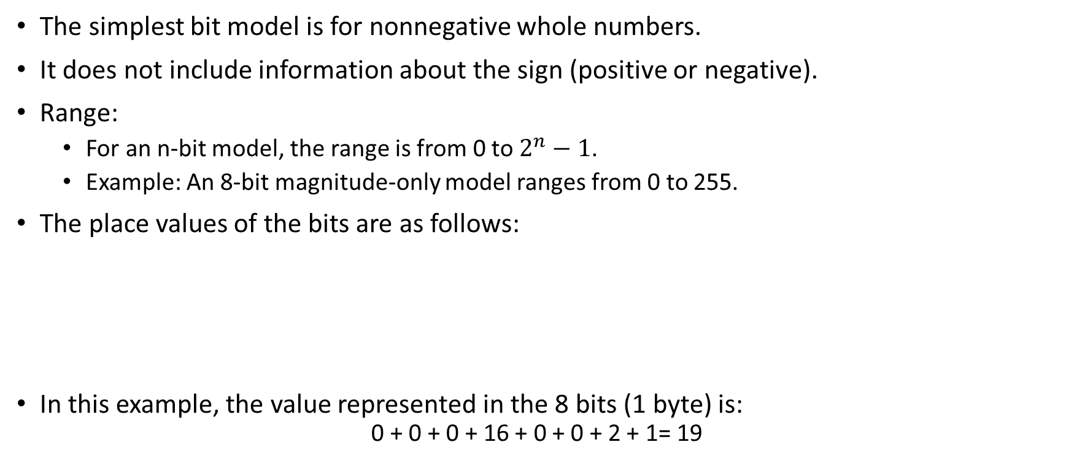
Magnitude-only Bit Model
The simplest bit model is for nonnegative whole numbers.
It does not include information about the sign (positive or negative).
Range:
For an n-bit model, the range is from 0 to $2^{n}−1$.
Example: An 8-bit magnitude-only model ranges from 0 to 255.
The place values of the bits are as follows:
In this example, the value represented in the 8 bits (1 byte) is:
$$\text{0 + 0 + 0 + 16 + 0 + 0 + 2 + 1= 19}$$

Slide 21
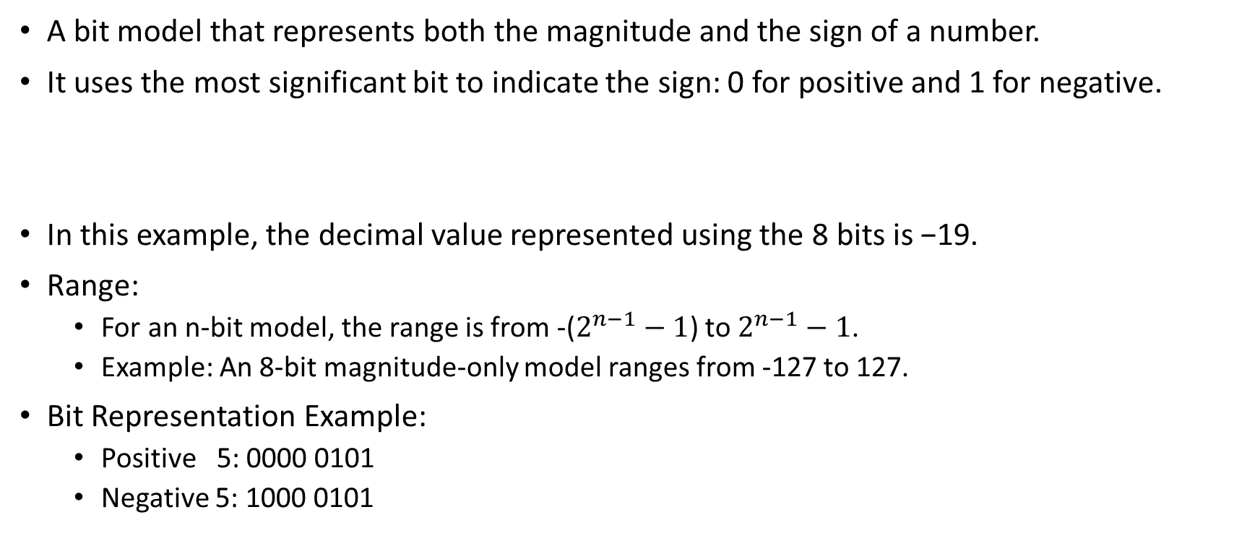
Sign-Magnitude Bit Model
A bit model that represents both the magnitude and the sign of a number.
It uses the most significant bit to indicate the sign: 0 for positive and 1 for negative.
In this example, the decimal value represented using the 8 bits is −19.
Range:
For an n-bit model, the range is from -($2^{n−1}−1$) to $2^{n−1}−1$.
Example: An 8-bit magnitude-only model ranges from -127 to 127.
Bit Representation Example:
Positive 5: 0000 0101
Negative 5: 1000 0101

Slide 22
Sign-Magnitude Bit Model
The sign-magnitude model suffers from two drawbacks.
First, notice that there are two possible bit values for zero: 00000000 can be interpreted as positive zero, while 10000000 is interpreted as negative zero.
This bit model makes binary addition complicated. Specifically, if we have one negative number and one positive number, we need to perform subtraction, but it would be easier if we could apply binary addition no matter the sign is.
Because of these two drawbacks, no data types in C use the sign-magnitude bit model.
It is usually seen only in simple computing circuits, or in design problems where these drawbacks do not present any difficulty.

Slide 23
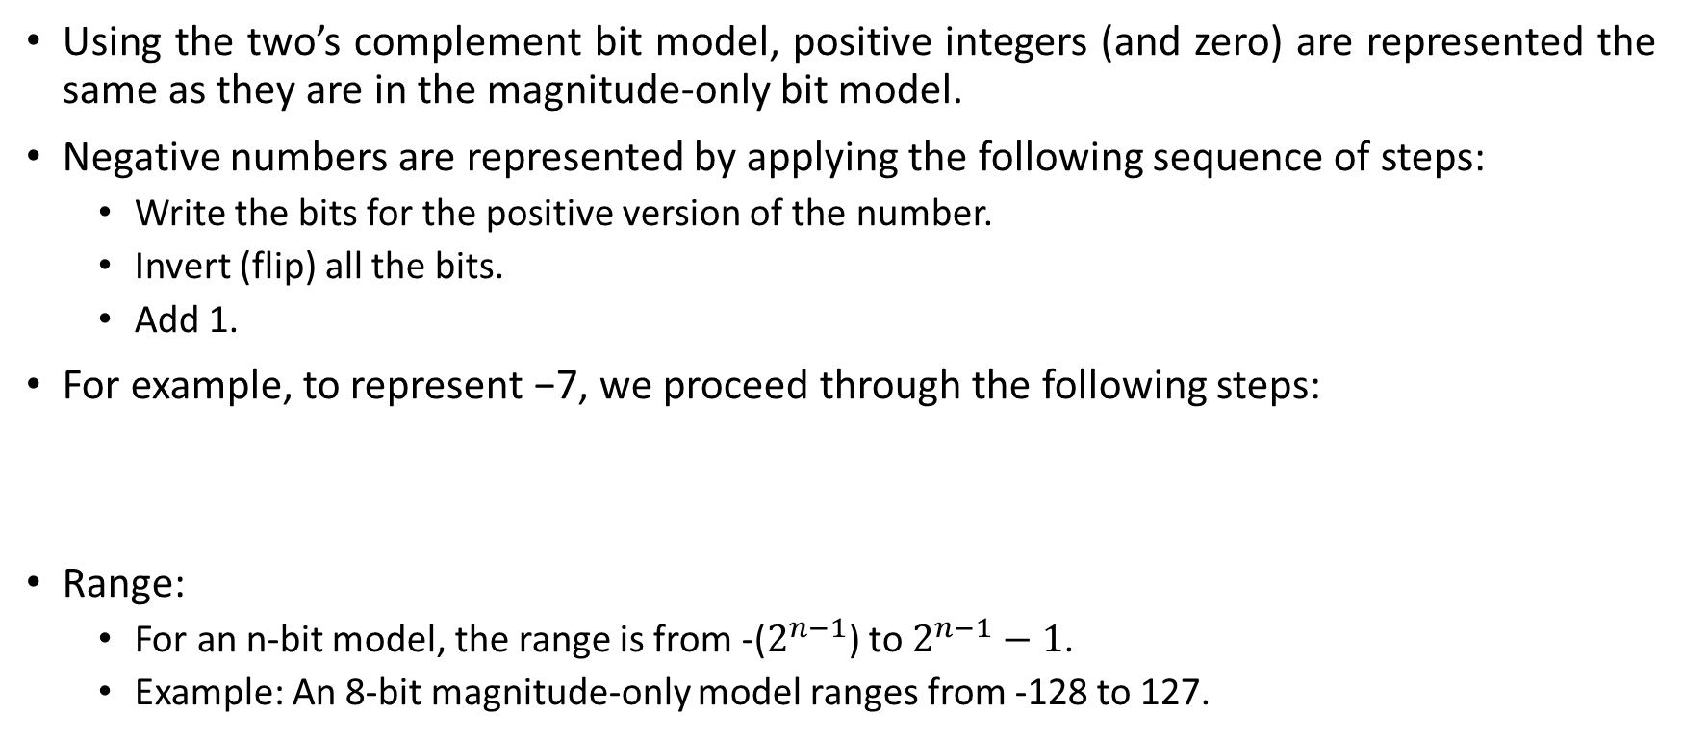
Two’s Complement Bit Model
Using the two’s complement bit model, positive integers (and zero) are represented the same as they are in the magnitude-only bit model.
Negative numbers are represented by applying the following sequence of steps:
Write the bits for the positive version of the number.
Invert (flip) all the bits.
Add 1.
For example, to represent −7, we proceed through the following steps:
Range:
For an n-bit model, the range is from -($2^{n−1}$) to $2^{n−1}−1$.
Example: An 8-bit magnitude-only model ranges from -128 to 127.
1111 1000
+ 1
--------------
1111 1001

Slide 24
Two’s Complement Bit Model
Two’s complement also makes addition and subtraction easier to implement because, regardless of the signs of the two numbers, they can always be added.
For example, consider 7 + (−5):
+5 = 00000101; inverted it becomes 11111010; and after adding 1 it becomes 11111011.
Several C data types use the two’s complement bit model:
a `char` uses 1 byte (8 bits) for the range -128 to 127,
an `int` uses 4 bytes (32 bits) for -2,147,483,648 to 2,147,483,647, and
a `short int` uses 2 bytes (16 bits) for -32,768 to 32,767.
This model is the most common for representing signed whole numbers in computing systems.

Slide 25
Other Bit Models
Floating Point bit model: A bit model used to represent real numbers (numbers with fractions) in computing.
The float data type uses 4 bytes to store a real number,
the double data type uses 8 bytes to store a real number. The double still uses 1 bit for sign, but it uses 11 bits to store the exponent and 52 bits to store the fraction, so that it can represent a wider range of numbers.
ASCII and Unicode Bit Models: In order to represent nonnumeric data, another bit model must be used.
The ASCII (American Standard Code for Information Interchange) bit model was developed to represent English text symbols, along with control characters necessary to print English text.

Slide 26
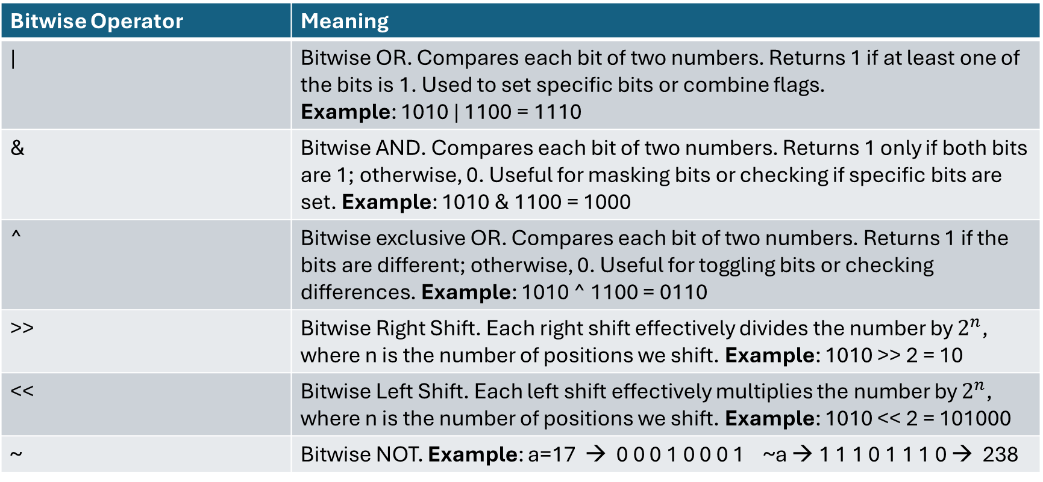
Bitwise Operators in C
Bitwise Operator | Meaning
| | Bitwise OR. Compares each bit of two numbers. Returns 1 if at least one of the bits is 1. Used to set specific bits or combine flags. Example: 1010 | 1100 = 1110
& | Bitwise AND. Compares each bit of two numbers. Returns 1 only if both bits are 1; otherwise, 0. Useful for masking bits or checking if specific bits are set. Example: 1010 & 1100 = 1000
^ | Bitwise exclusive OR. Compares each bit of two numbers. Returns 1 if the bits are different; otherwise, 0. Useful for toggling bits or checking differences. Example: 1010 ^ 1100 = 0110
>> | Bitwise Right Shift. Each right shift effectively divides the number by $2^{n}$, where n is the number of positions we shift. Example: 1010 >> 2 = 10
<< | Bitwise Left Shift. Each left shift effectively multiplies the number by $2^{n}$, where n is the number of positions we shift. Example: 1010 << 2 = 101000
~ | Bitwise NOT. Example: a=17 → 0 0 0 1 0 0 0 1 ~a → 1 1 1 0 1 1 1 0 → 238

Slide 27
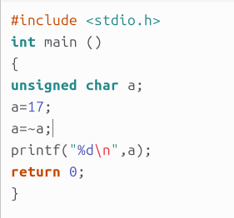
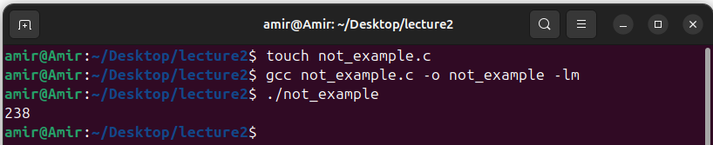
Example 7: Bitwise NOT Operator
The bitwise NOT operator inverts every bit in a variable. It is written using the tilde symbol (~). For example:

Slide 28
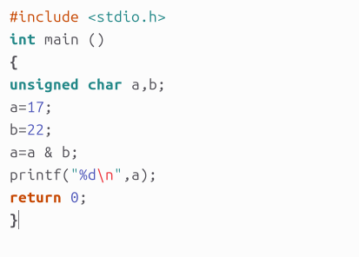
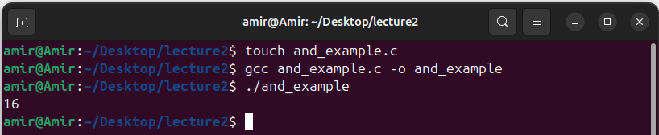
Example 8: Bitwise AND Operator
The bitwise AND operator performs an AND between two variables, independently at every bit. It is written using the ampersand symbol (&). For example:

Slide 29
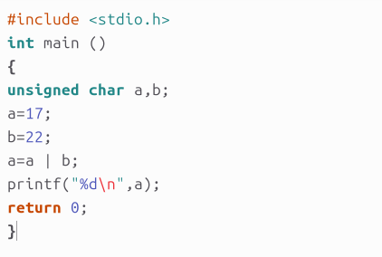
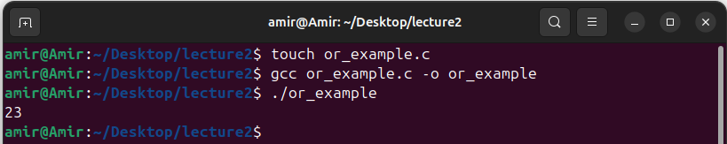
Example 9: Bitwise OR Operator
The bitwise OR operator performs an OR between two variables, independently at every bit. It is written using the vertical bar symbol (|). For example:

Slide 30
Example 10: Bitwise Operators
Write a C program that asks the user to enter two integers (each integer has 4 bytes/32 bits). The program should then perform the following bitwise operations on these integers and print the results:
AND (‘&’) | OR (‘|’) | XOR (‘^’) | Left Shift (‘<<’) by 1 | Right Shift (‘>>’) by 1
1100 (12) & 1010 (10) ---- 1000 (8) | 1100 (12) | 1010 (10) ---- 1110 (14) | 1100 (12) ^ 1010 (10) ---- 0110 (6) | 1010 << 1 ---- 00010100 (20) | 1010 >> 1 ---- 0000 0101 (5)

Slide 31
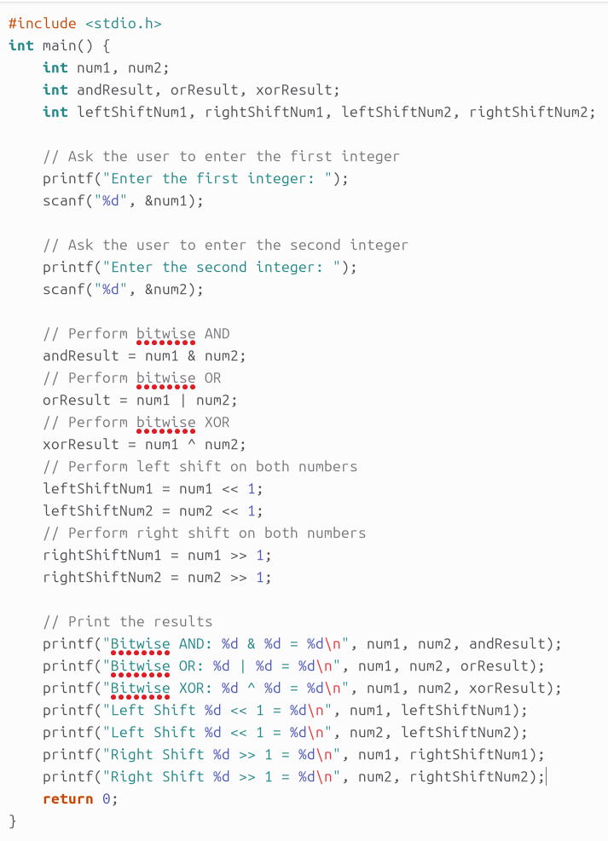
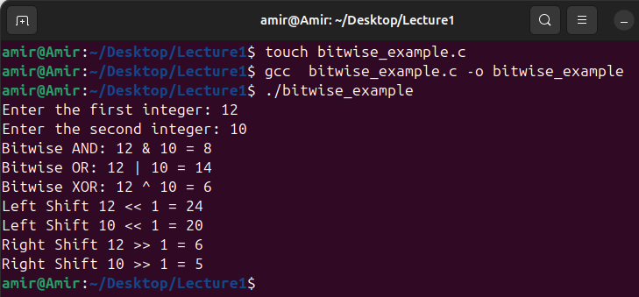
Example 10: Bitwise Operators

Slide 32
Bitmask Operations
Bitmasking is perhaps the most common type of bitwise operation.
Bitmasking involves using bitwise operators to selectively change specific bits within a variable.
The three most common bitmask operations are:
Use bitwise OR to set specific bits to 1 in a variable.
Use bitwise AND with a complemented bitmask to clear specific bits.
Extract and interpret the value of the Nth bit from a number

Slide 33
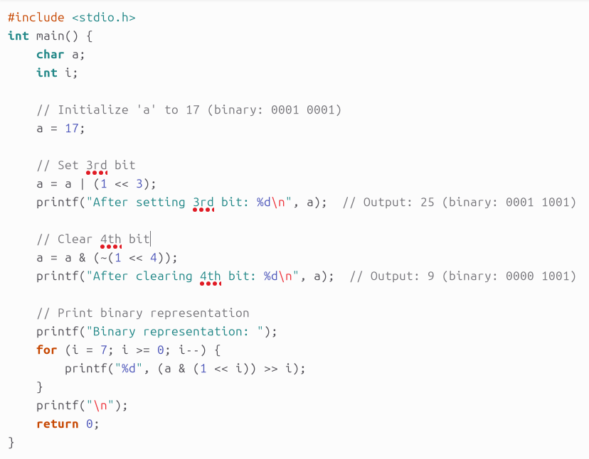
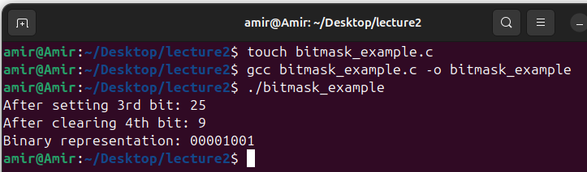
Example 11: Bitmask Operations
Write a C program that demonstrates setting, clearing, and reading bits in a variable a of type char. Perform the following operations:
Set the 3rd bit of a.
Clear the 4th bit of a.
Print the binary representation of a after performing the above operations.

Slide 34
Example 11: Explanation
Setting 3rd bit: a | (1 << 3) sets the 3rd bit of variable a by performing a bitwise OR operation with a bitmask where only the 3rd bit is 1.
1 << 3 shifts 0000 0001 to become 0000 1000.
Clearing 4th bit: a & (~(1 << 4)) clears the 4th bit of variable a by first creating a bitmask where only the 4th bit is 0 (using bitwise NOT and AND operations).
The expression 1 << 4 in C is a bitwise left shift operation, where 1 (0000 0001) is shifted to the left by 4 positions and becomes. This operation effectively multiplies 1 by 2 four times, resulting in 16 (0001 0000).
Reading bits: The for loop iterates from the most significant bit (bit 7) to the least significant bit (bit 0), printing each bit of a using a bitwise AND operation with a bitmask for each bit position.

Slide 35
Arrays
Beyond the four basic data types (char, int, float, double), the C language supports some advanced data constructs.
These include
Arrays,
strings,
pointers and
structures.
Like the basic data types, each of these advanced data constructs is intended to store something different.

Slide 36
Arrays
Arrays are intended to group together a list of values, all of the same type, under one variable name.
Instead of declaring individual variables, such as number0, number1, ..., and number99, you declare one array variable such as numbers and use numbers[0], numbers[1], and ..., numbers[99] to represent individual variables.
For instance:
for (i=0; i<100; i++) /* array coding */
sum=sum+qty[i];
sum=qty1+qty2+qty3+... /* without an array */

Slide 37
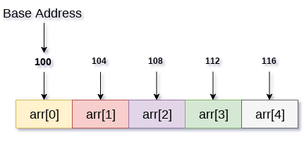
Arrays
All arrays consist of contiguous memory locations.
The lowest address corresponds to the first element and the highest address to the last element.
The size of each cell is dictated by the data type:
int a[2]; /* 2 cells, each cell 4 bytes (32 bits) */
float b[3]; /* 3 cells, each cell 4 bytes (32 bits) */
double c[4]; /* 4 cells, each cell 8 bytes (64 bits) */
char d[5]; /* 5 cells, each cell 1 bytes (8 bits) */
int arr[5]

Slide 38
Arrays
Format:
arrayname[ position number ]
First element at position 0
n element at position n-1
Example: array named c:
c[ 0 ], c[ 1 ]...c[ n – 1 ]
Cells are accessed using indices:
a[0]=5;
b[1]=4.0;
c[2]=14.7;
d[4]=‘a’;

Slide 39
Arrays
To declare an array in C, a programmer specifies the type of the elements and the number of elements required by an array as follows:
type arrayName [ arraySize ];
This is called a single-dimensional array.
The arraySize must be an integer constant greater than zero and type can be any valid C data type.
double balance[10];
Here balance is a variable array which is sufficient to hold up to 10 double numbers.

Slide 40
Arrays
Array elements can be initialized like normal variables
c[ 0 ] = 3;
printf( "%d", c[ 0 ] );
As you see you can initialize an array in C one by one.
Another way is to use a single statement as follows:
double balance[5] = {1000.0, 2.0, 3.4, 7.0, 50.0};
The number of values between braces { } cannot be larger than the number of elements that we declare for the array between square brackets [ ].

Slide 41
Arrays
If you omit the size of the array, an array just big enough to hold the initialization is created. Therefore, if you write:
double balance[] = {1000.0, 2.0, 3.4, 7.0, 50.0};
You will create exactly the same array as you did in the previous example.
If you want to change one of the elements (e.g. 5th element) of your array you can write as follows: balance[4] = 40.0;
Assume that: int n[ 5 ] = { 1, 2, 3, 4 }; Since there is not enough initializers, rightmost elements become 0.
If too many initializers, a syntax error occurs.

Slide 42
Example 12: Basic array Operations
Write a C program to perform the following operations on a single-dimension array of integers:
Input Array Elements: Prompt the user to enter the number of elements in the array and then input the elements.
Find the Maximum and Minimum Values: Determine and display the maximum and minimum values in the array.
Compute the Average: Calculate and display the average of the array elements.
Reverse the Array: Reverse the order of elements in the array and display the reversed array.

Slide 43
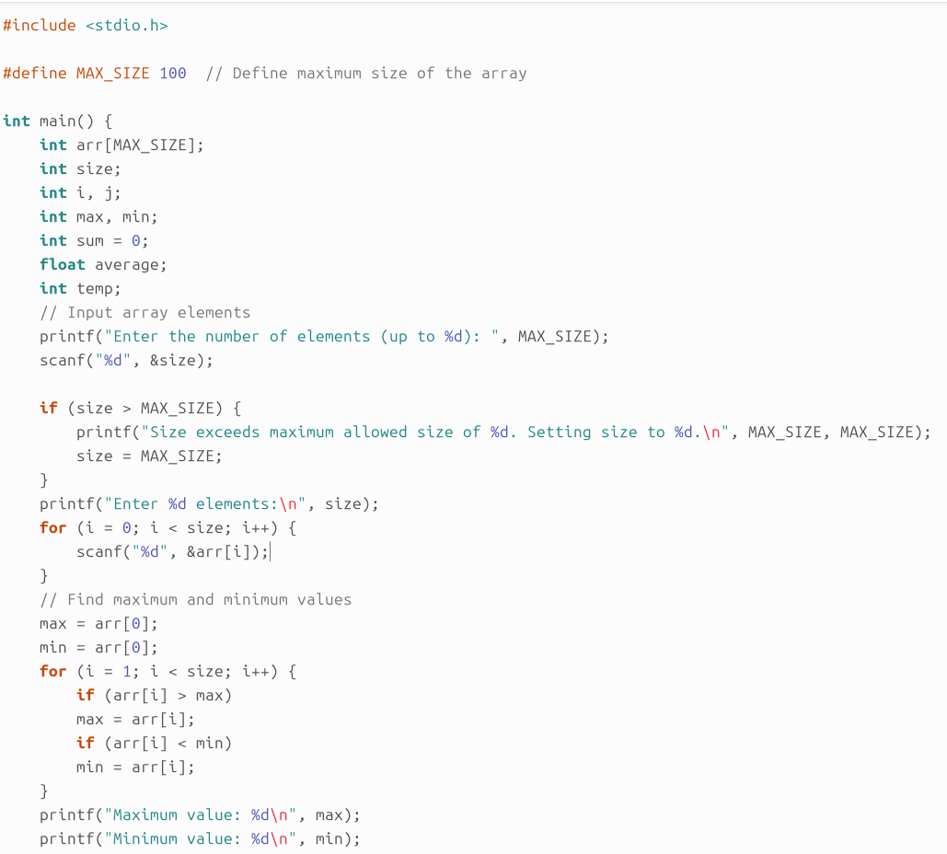
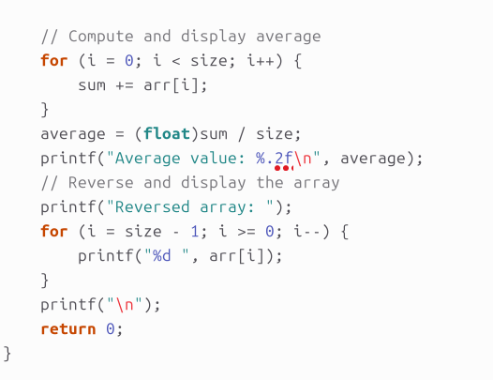
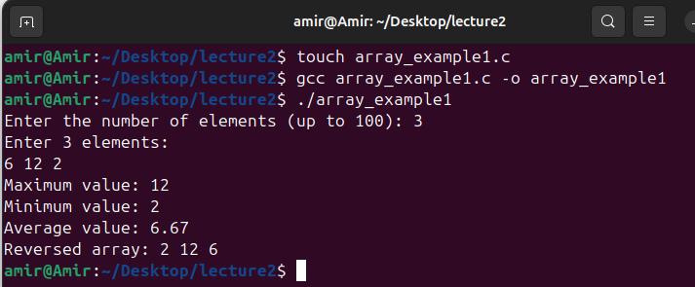
Example 12: Basic array Operations

Slide 44
Example 12: Explanation
Array Initialization: The program initializes an array with a fixed maximum size (MAX_SIZE), which is a common practice in system programming to avoid dynamic memory allocation for simplicity.
Input Handling: The user is prompted to enter the number of elements and then the elements themselves.
Find Max and Min: The maximum and minimum values are determined by iterating over the array.
Compute Average: The average of the array elements is calculated by summing the elements and dividing by the number of elements.
Reverse Array: The array is reversed by iterating from the end to the beginning and displaying the reversed elements.

Slide 45
Example 13: Sorting array
Write a C program to perform the following operations on a single-dimension array of integers:
Input Array Elements: Prompt the user to enter the number of elements in the array and then input the elements.
Sort the Array: Sort the array in ascending order using the Bubble Sort algorithm.
Display the Array: Print the sorted array.

Slide 46
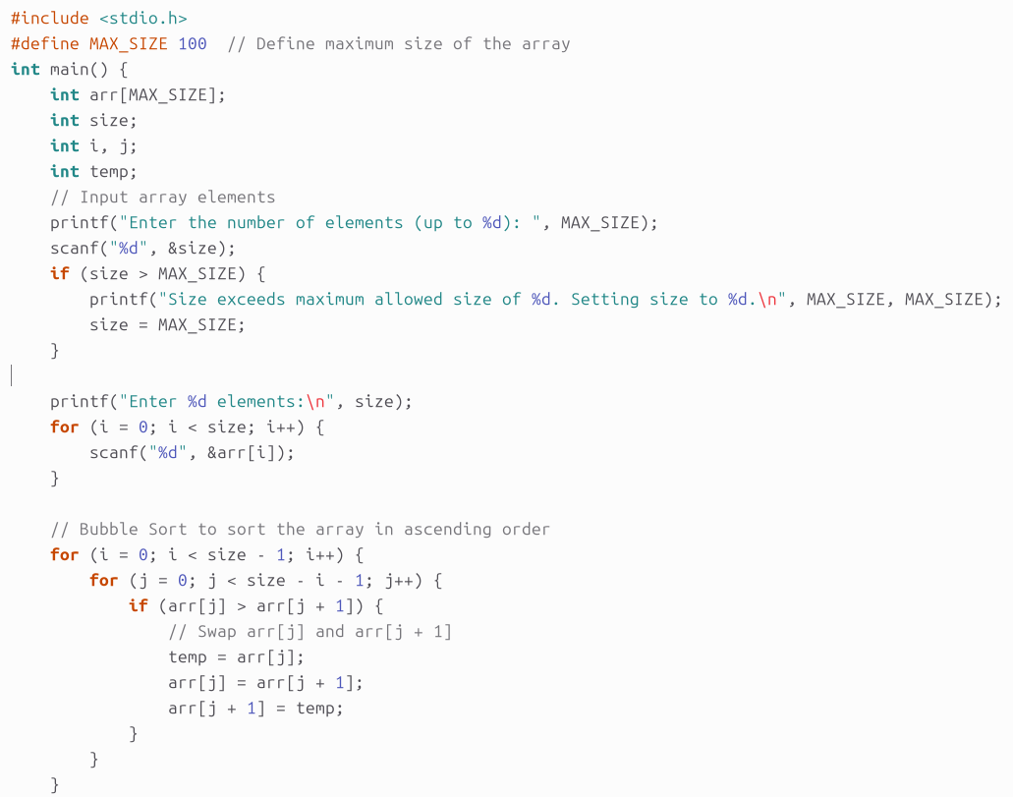
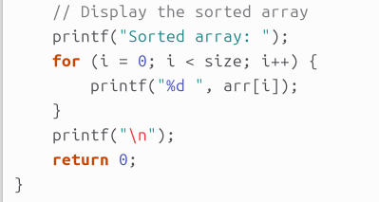
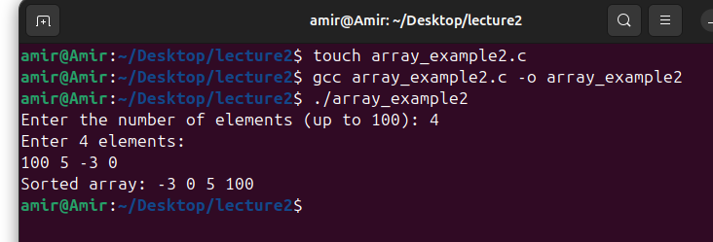
Example 13: Sorting array

Slide 47
Example 13: Explanation
Array Declaration and Initialization:
#define MAX_SIZE 100: Sets the maximum size of the array.
int arr[MAX_SIZE];: Declares an array with a maximum of 100 elements.
int size, i, j, temp;: Declares variables for the number of elements, loop indices, and a temporary variable for swapping.
Input Array Elements:
printf("Enter the number of elements (up to %d): ", MAX_SIZE); scanf("%d", &size);: Asks and reads the number of elements.
if (size > MAX_SIZE) size = MAX_SIZE;: Adjusts size if it exceeds the maximum allowed.
for (i = 0; i < size; i++) scanf("%d", &arr[i]);: Reads array elements.
Sorting the Array (Bubble Sort):
Outer loop for(i = 0; i < size - 1; i++) iterates through the array.
Inner loop for(j = 0; j < size - i - 1; j++) compares adjacent elements.
if (arr[j] > arr[j + 1]) { temp = arr[j]; arr[j] = arr[j + 1]; arr[j + 1] = temp; }: Swaps elements if needed.
Display the Sorted Array:
printf("Sorted array: ");: Indicates that the sorted array will follow.
for (i = 0; i < size; i++) printf("%d ", arr[i]);: Prints each element.
printf("\n");: Moves to the next line after printing.

Slide 48
Multi-Dimension Arrays
Arrays in C can have more than one dimension.
However, computer memory is organized linearly (one-dimensional).
Multidimensional arrays are stored in one-dimensional order in memory as memory does not have a special multidimensional space.
Example: int a[3][2]; a[0][1]=7; a[1][0]=13;
The memory map for this code could be written as:
There are a total of six cells in this array.
They are listed in order by cycling through the range on the rightmost index, incrementing the next index to the left when done.
Stored as a single sequence in memory

Slide 49
Multi-Dimension Arrays
The same procedure works for any number of dimensions.
For example, consider the following code for a three-dimensional array:
int b[2][3][4]; b[0][2][0]=7; b[1][0][2]=13;
There are 24 cells in this array, occupying a total of 96 bytes. The memory map for this code could be written as:
The order of incrementing dimension indices is similar to how base 10 numbers are counted, cycling through the one’s digit before incrementing the ten’s digit, then cycling through the ten’s digit before incrementing the hundred’s digit, and so on.
Everything stored in computer memory is somehow stretched out in one-dimensional order.
Things not typically viewed as one-dimensional, such as images, video, databases, maps, and three-dimensional models are all actually stored by listing out the data in one-dimensional order

Slide 50
Example 14: Two-Dimension Array
Write a C program to perform the following operations on a 2-dimensional array of integers:
Input Array Elements:
Ask the user to enter the number of rows and columns for the array.
Input the elements of the array from the user.
Find Duplicate Values:
Identify and print duplicate values within the matrix.
For each duplicate value, print the positions (row and column) where the duplicate values occur.

Slide 51
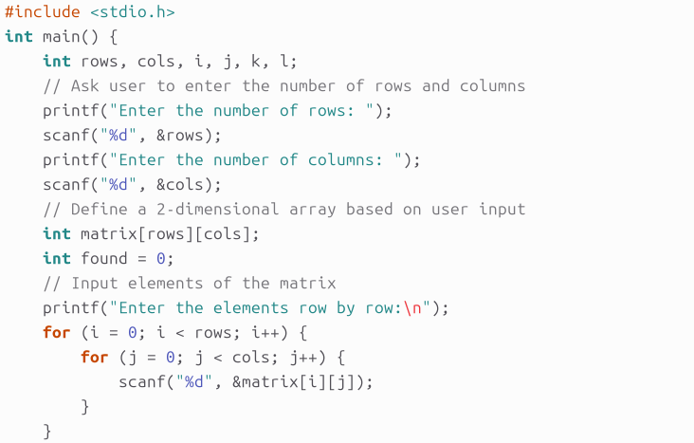
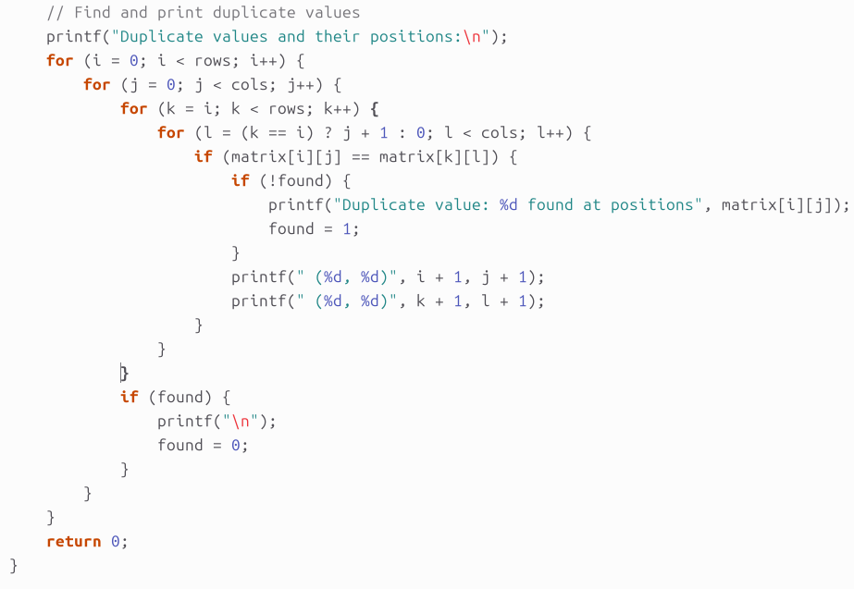
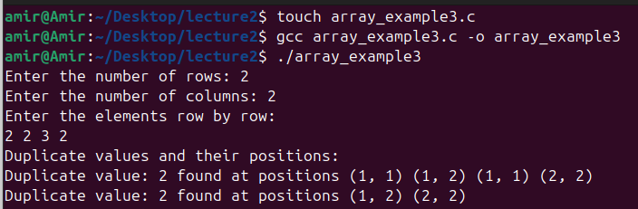
Example 14: Two-Dimension Array

Slide 52
Example 14: Explanation
Input Array Elements:
Prompt the user for the number of rows and columns.
Read the matrix elements from the user using nested loops.
Outer Loops:
These loops iterate through each element of the matrix.
i represents the current row, and j represents the current column.
Inner Loops:
The outer loop k starts from the current row i to the last row. This ensures that we only compare each element with elements that appear later in the matrix.
The inner loop l starts from j + 1 if k is equal to i (i.e., when we are still on the same row as i). This prevents comparing the element with itself and ensures we only find duplicates in later columns or rows.

Slide 53
Example 14: Explanation
Check for Duplicate:
This condition checks if the element at position (i, j) is equal to the element at position (k, l).
Print Duplicate Information:
If this is the first time a duplicate value is found (!found), print a message indicating that a duplicate value is found and set found to 1.
Print the positions of the duplicate values in a 1-based format by adding 1 to the zero-based indices.
Reset for Next Value:
After checking all possible positions for duplicates of the current value, if any duplicates were found (found is 1), print a newline for clarity.
Reset found to 0 for the next unique value.

Slide 54
Thank you for listening

